Slide 1

Foundations of Entrepreneurship
Lecture Note #17
Marketing Research?
17.02.2021

Slide 2
Ignore the slides with a cross mark

Slide 3
Concepts Covered:
Define marketing research.
Highlight the importance of market-information at every stage of a company.
Outline the step-by-step marketing research process.
Sources of information
Discuss how companies use the information for decision making.
Notes:
This is definitely not a comprehensive list.

Slide 4


Suspect/
Prospect
Awareness
Interest
100
Consideration
75
Intent
50
Evaluation
25
Purchase
Reference
Output

Slide 5
“It is a capital mistake to theorise before one has data”
Sir Arthur (Ignatius) Conan Doyle
(22 May 1859 – 7 July 1930)
The author of detective stories (crime fiction) Sherlock Holmes

Slide 6
Market(ing) Research: Definition. Is about gathering relevant information
Marketing research is the systematic design of experiment, collection of data, their analysis and reporting the information relevant to a specific marketing situation facing the organisation and to help making decisions.
Market research provides data helping to identify market pain, understand market structure, customer segment, target market, competition, product positioning, design advertisement campaign to identify and reach your target market at a price customers are willing to pay.

Slide 7
Definition of Market Research (MR)
The American Marketing Association defines
“Marketing Research: as the function which links the consumer, customer and public to the marketers through information that is used to identify and define marketing opportunities and problems; refine and evaluate marketing actions, monitor marketing performance and improve understanding of marketing as a process.”

Slide 8
American Marketing Research Association
The function which links the consumers, the customers, and public to the marketers through INFORMATION.
Companies use marketing research in a wide variety of situations. It helps marketer to understand customer satisfaction & purchase behaviour. Thus, it helps them to assess market potential & market share or to measure the effectiveness of pricing , product, distribution, & promotion activities.

Slide 9
Sources
Type
Collect data to make decisions
Purpose

Slide 10
Definition in Wikipedia
Marketing research is "the process or set of processes that link(s) the producers, customers, and end users to the marketer through information used to identify and define marketing opportunities and problems; generate, refine, and evaluate marketing actions; monitor marketing performance; and improve understanding of marketing as a process. Marketing research specifies the information required to address these issues, designs the method for collecting information, manages and implements the data collection process, analyses the results, and communicates the findings and their implications."

Slide 11




Marketing Research Helps to
Identify unmet demand and identify opportunities
Understand market needs, preferences, aspirations and helps to refine offerings
Evaluate customers’ satisfaction and marketing performance
Improve product/service, customer satisfaction, and acquire and retain growing number of loyal customers
Information emerging out of market research helps to

Slide 12
Marketing Research is a Systematic and Objective Process of
design research methodology,
collect market data,
analyze to generate information,
disseminate the information to decision makers,
use the information for improving decision making to create customer value and satisfaction and gain increasing access to market for achieving profitable growth.

Slide 13
Marketing research gives decision-makers the information they need to find solutions to business problems, such as the following:
How satisfied are customers with your product and service offering?
How will customers react to a decision to change a price or product or to a new product or service?
What are service representatives hearing from customers?
What responses to competition will bring you success in a given market?

Slide 14
Role of Marketing Research
The task of marketing research is to provide management with relevant, accurate, reliable, valid, and current information.
Competitive marketing environment and the ever-increasing costs attributed to poor decision making require that marketing research provide sound information.
Sound decisions are not based on gut feeling, intuition, or even pure judgment. It must be based on data.

Slide 15
Importance of Marketing Research
Managers make numerous strategic decisions in the process of identifying potential opportunities, target market selection, market segmentation, planning and implementing marketing programs, marketing performance, satisfying customer needs, and control.

Slide 16

An Example: Research on Agatha Christie
In 1985, HarperCollins found sales of Agatha Christie
novels declining.
They commissioned quantitative & qualitative research.
It revealed that readers liked the “niceness” of the crimes,
but covers were gruesome and bloody.
New cover designs commissioned.
Results: the first year sales rose 40%.
Image courtesy: https://www.flickr.com/

Slide 17
Activities for Which Market Research Is Performed
Awareness, Attitudes & Usage research
Public relation research
Advertising research
Market segmentation
Positioning, Branding research
Industry & Competition analysis
Awareness
Targeting
Qualitative
&
Quantitative
Qualitative
&
Quantitative
Retention
Acquisition
Customer satisfaction & loyalty research
Customer communication testing
Usability testing
Customer experience /
Shopper insights
Concept testing
Product optimization
Pricing research
Advertising research
Usability testing

Slide 18
Market research
Identify trend
Competition analysis
Price analysis
SWOT analysis
Target market analysis
Marketing plan
Market segmenting
Market structure
Objectives for Marketing Research

Slide 19
SWOT Analysis
Weaknesses
Strengths
Areas where the company is weak and needs to improve
Where the company excels better than competitors
S
W
Threats
Opportunities
Favourable external and internal factors that the company can exploit to build competitive advantage
Factors that can harm the performance of the company or weaken its competitive advantage
T
O

Slide 20
Research Approaches/Methods Currently in Use
The following two slides provide information on the adoption of the research approaches/ methods in use or under consideration by the market research population.
This information is purely for personal use by entrepreneurs. You are not expected to memorize any data from these tables.
The full data are available in the following site.
https://www.greenbook.org/PDFs/2018_Q3_Q4_GRIT_Report.pdf

Slide 21
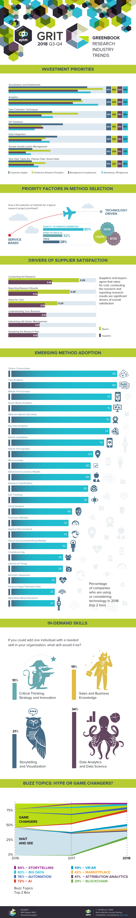

Slide 23
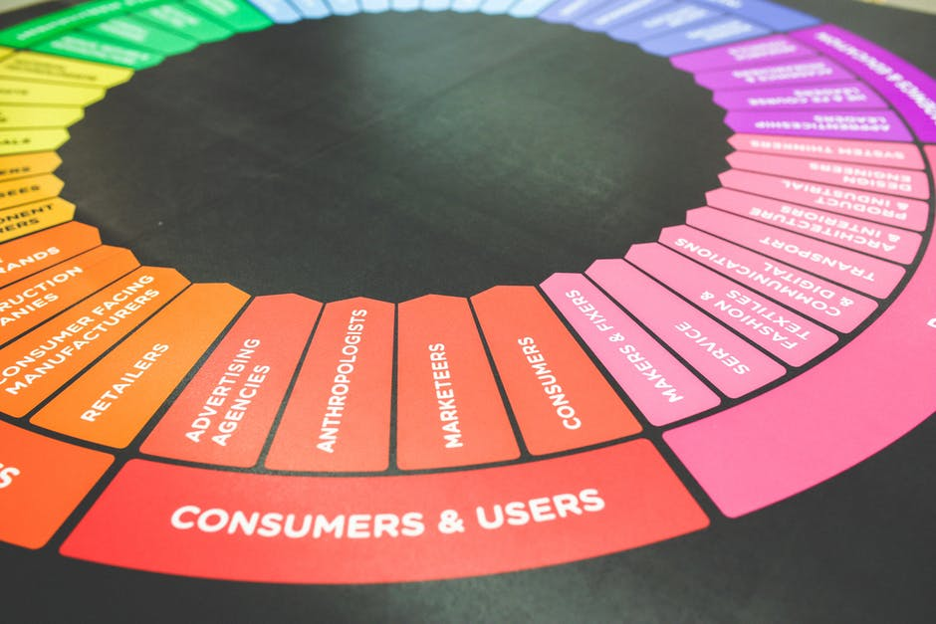
Marketing Research Starts at the Very Outset
The first step to start a business is to know ‘who are your customers’.
Where to find them?
What do they buy at present that your product would replace?
What features and quality standards?
At what price?

Slide 24

Marketing Research Starts at the Outset … cont’d.
Understanding customers’ response at every stage is indispensable.
Notably, feedback from innovator kind of customers may not be any good to gauge the purchase decisions of the majority.

Slide 25
Marketing Research Continues as Long as the company exists
Market research has to be a regular activity and would help to decide
whether you need to continue to develop further,
what features to focus more/less,
what features to discard/add.
Customers are integral part of product development process and they can help avert developing the wrong product.
Market research, thus, may eliminate the chance of customer rejecting/not buying the product when launched.

Slide 26
Why market research for start-ups
Ideally, marketing research starts while ‘identifying pain point’.
Attractiveness of the market depends on:
The size of the market
Historical growth
Present growth
Future growth potential
Market types (perfect competition, monopolistic competition, oligopoly, monopoly)
Market research helps to understand above features.
Market structure

Slide 27
Why market research for start-ups … cont’d.
Market research helps to understand customers’ likely acceptance of product or service even before they are launched.
In line with the lean method, one should continue the development process based on validated learning.
You need to engage with customers to validate, learn and decide.

Slide 28
DECIDE Model of Steps in Marketing Research
D – Define the marketing problem
E – Enumerate the controllable and uncontrollable decision factors
C – Collect relevant information
I – Identify the best alternative method and type of data
D – Develop and implement a marketing plan
E – Evaluate the decision and the decision process

Slide 29
Issues in Market(ing) Research
Spend on Market(ing) Research
Types of Market(ing) Research
Potential Problems

Slide 30



Types of Market Research
- Primary
- Secondary
- Quantitative
- Qualitative
- Exploratory
- Descriptive
- Causal or Experimental
By Source of Data or information
By Methodology or
type of data
By Objectives

Slide 31
Qualitative and Quantitative Market Research
The quantitative research answers the what, where, when and who of decision making.
The goal of quantitative research is to quantify and generalize the results so that the marketer can come to a final conclusion about the best course of action.
Large sample, statistical data that describe a market.
Survey technique
Qualitative market research is done using observation or unstructured questioning.
The qualitative research, on the other hand answers the why and how.
The goal of qualitative research is to gain insights into the deeper motives behind consumer purchases.
To understand trend and motivation to buy.
Focused group, individual interview, group discussion.

Slide 32


QUALITATIVE
QUANTITATIVE

Objectives and Method
Objectives and Methods
The quantitative research answers the what, where, when and who of decision making.
The goal of quantitative research is to quantify and generalize the results so that the marketer can come to a final conclusion about the best course of action.
Large sample, statistical data that describe a market.
Survey technique
Qualitative market research is done using observation or unstructured questioning.
The qualitative research, on the other hand answers the why and how.
The goal of qualitative research is to gain insights into the deeper motives behind consumer purchases.
To understand trend and motivation to buy.
Focused group, individual interview, group discussion.

Slide 33
Information Sources
Primary source – information collected directly and primarily for the problem at hand.
Secondary source – information collected routinely for general consumption or for other specific problem and are used for the current problem.
The cost, resources and time requirement for gathering primary information are generally high and at times prohibitive.
Secondary information is cheaper and faster to collect than primary information.
Some secondary information is available in published sources.

Slide 34
Primary and Secondary sources of data
Data gathering from primary source
5 Methods

Slide 35
Primary Market Research: 5 Methods
If you want objective decision making based on specific metric, using a large sample, you have the resources: adopt the primary method of data collection.
Focus
groups
Experiment &
field trial
Survey
Interview
Observation
Most widely
utilized
Target
demographic
Deep Exploration
Scientific testing
Observe closely
Qualitative method. Deeper perspective on customer problems, psychological motivations and underlying perceptions.
Use usability test, eye tracking, contextual inquiry, in-home observation, mystery shopper.
Can test specific hypotheses. Quantitative in nature. A/B test used by Barak Obama team for donation.
Objective, specific metric, large sample, need adequate resources.
Particular demographic response to product. Focus groups suitable for exploratory & qualitative research.
New product launch
New product testing0
Testing of hypothesis/
Feature testing/ price, packaging, aesthetics
Food
Game console or voting
Notes:
The power of using varying hues of the same color

Slide 36
Primary Research Methods
Survey
Focus groups
Interview
Experiment & field trial
Observation
Survey: You want objective decision making based on specific metric. You have a large sample and have the necessary resources.
People of particular demographic are chosen to respond to product or service. Quantitative.
Focus group: Focus groups are people of similar demographic, homogenous in certain parameters, such as college gamers, newly wed women, new moms. They are brought together and interacted by a moderator to gain information relevant to the research problem. Excellent for exploratory and qualitative research.

Slide 37
Primary Research Methods
Interview
Experiment & field trial
Observation
Individual interviews: Is a qualitative market research method. Use this method to dig into a specific issue very deeply, to search for customer problems, understand psychological motivations and underlying perceptions.
Experiments & Field Trial: Scientific testing, where a specific hypothesis can be tested. Quantitative in nature. A/B test used by Barak Obama team for donations.
Observations: Use usability testing, eye tracking, contextual inquiry, in-home observation, mystery shopper.

Slide 38
Create simple user personas – a semi fictional character based on psychographic and demographic data from people relevant to your products. Use a short and direct questionnaire.
Conduct observational research – you received unbiased reflection of customers on your products.
Conduct individual interviews – One-on-one conversation. Listen more and talk less. Avoid leading or loaded questions.
Analyze the data – wrap your head around the data without losing yourself in it.
Try to visualize/create an actionable customer journey map – steps in the sales cycle from awareness to repurchase and advocacy

Slide 39
Market research (or marketing research) is any set of techniques used to gather information and better understand a company’s target market. Businesses use this information to design better products, improve user experience, and craft a marketing message that attracts quality leads and improves conversion rates.

Slide 40
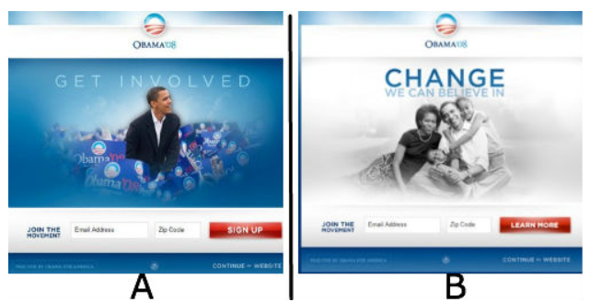
Experimental or Field Trial: A/B Test in Action
Screenshot from https://www.mymarketresearchmethods.com/

Slide 41
Lessons Learned from the Experiment
Every visitor to your website is an opportunity – they may or many not convert into customers. You may know what motivates them.
Question assumptions – they learned that images did better than video. Question your own assumptions!
Experiment early and often – they experimented early and discovered the necessary change, and achieved unexpected success.
Screenshot from https://blog.optimizely.com

Slide 42
Types of Market Research
- Primary
- Secondary
- Quantitative
- Qualitative
- Exploratory
- Descriptive
- Causal or Experimental
By Objectives
By Source of Data or information
By Methodology

Slide 43
Market Survey Considerations
1. Make sure that every question is necessary
2. Keep it short and simple
3. Ask direct questions
4. Ask one question at a time
5. Avoid leading and biased questions
6. Speak your respondent’s language
7. Use response scales whenever possible
8. Avoid using grids or matrices for responses
9. Rephrase yes/no questions if possible
10. Take your survey for a test drive

Slide 44
Careful how you ask the question
Q. Do you approve of smoking whilst praying?
A: No
Q. Do you approve of praying whilst smoking?
A:Yes

Slide 45
Example of successful research
Coke saw decline in the market share in the late 1970s and early 1980s
The Coca-Cola company had evidence that taste was the cause.
A new product dubbed “New Coke” was developed that was sweeter than the original-formula Coke. Sale declined further.
Almost 200,000 blind product taste tests were conducted in the United States, and more than one-half of the participants favored Old Coke over New Coke.
Ultimately, New Coke was withdrawn from the market.

Slide 46
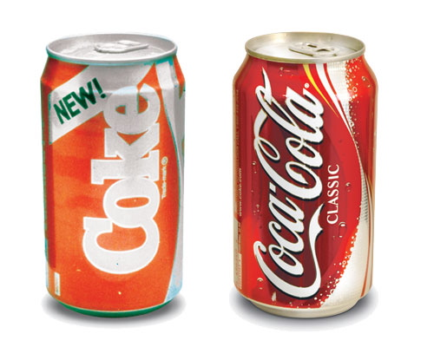
Coca Cola Failure and Success
Coke was losing market-share
May 1985 Old Coke withdrawn
New Coke introduced presuming customer prefer sweeter taste
The strategy failed.
July 1989 Old Coke reintroduced as Coke Classic and ales went up.

Slide 47
Methods |  | Qualitative or Quantitative | Cost | Time | Suggestions
Secondary |  | Both | Low. Free in some contexts. | Short | Get a bird's eye view or a ballpark estimate. Good to start with.
Primary | Survey | Qunatitative | Usually costly. Cost elements: Participants incentive, survey design, survey administration | Medium | Gain insight on specific parameters. Get reliable information.
 | Focus groups | Qualitative | Medium. Cost elements: Group moderation and participant incentives. | Medium | Slightly deeper probing than exploratory.
 | Interviews | Qualitative | Medium. Depends on the sample size. | Short-Medium | Deeper than exploratory. Gain insight on specifics.
 | Experiments & Field trial | Qunatitative | Most expensive | Usually long | Used for testing hypothesis. Reliable inference.
 | Observation | Qualitative | Medium. Depends on complexity of the problem. | Medium | Gain knowledge about actual behavior free of bias of respondents

Slide 48
Methods |  | Qualitative or Quantitative | Cost | Time | Suggestions
Secondary |  | Both | Low. Free in some contexts. | Short | Get a bird's eye view or a ballpark estimate. Good to start with.
Primary | Survey | Qunatitative | Usually costly. Cost elements: Participants incentive, survey design, survey administration | Medium | Gain insight on specific parameters. Get reliable information.
 | Focus groups | Qualitative | Medium. Cost elements: Group moderation and participant incentives. | Medium | Slightly deeper probing than exploratory.
 | Interviews | Qualitative | Medium. Depends on the sample size. | Short-Medium | Deeper than exploratory. Gain insight on specifics.
 | Experiments & Field trial | Qunatitative | Most expensive | Usually long | Used for testing hypothesis. Reliable inference.
 | Observation | Qualitative | Medium. Depends on complexity of the problem. | Medium | Gain knowledge about actual behavior free of bias of respondents

Slide 49
Market Research: By Methodology
- Primary
- Secondary
- Quantitative
- Qualitative
- Exploratory
- Descriptive
- Causal or Experimental
By Source of Data or information
By Objectives
By Methodology
By data-type

Slide 50


Qualitative Versus Quantitative
Qualitative research is exploratory in nature. Usually gathers data using focus groups, triads, dyads, in-depth interviews, uninterrupted observation, bulletin boards, and ethnographic participation or observations. Less objective.
Quantitative research looks to quantify a problem, involves collection of data through surveys in different modalities (online, phone, paper), points of purchase (purchase transactions), and click-streams. More objective.

Slide 51
Types of Market Research: By Methodology
 | Qualitative | Quantitative
Type of Question | Probing | Simple
Sample Size | Small | Large
Information per respondent | High | Low(ish)
Questioner’s skill | High | Low(ish)
Analyst’s skill | High | High
Type of analysis | Subjective | Objective
 | Interpretive | Statistical
Ability to replicate | Low | High
Areas probed | Attitudes | Choices
 | Feelings | Frequency
 | Motivations | Demographic

Slide 52
Benefits of Qualitative Market Research over Quantitative
Qualitative
Comment/Example
Cheaper compared to quantitative
Smaller sample size
Allows managers to observe (through one way mirror) ‘real’ consumer reaction to the stimulation - e.g. comments and associations regarding a new product fresh from the lab
Probes in-depth motivations and feelings
Often useful precursor to quantitative research
Gives a low cost and timely sense of which issues to probe in quantitative research

Slide 53
Market Research by Objectives
- Primary
- Secondary
- Quantitative
- Qualitative
- Exploratory
- Descriptive
- Causal or Experimental
By Source of Data or information
By Objectives
By Methodology

Slide 54
Market Research: By Objective
Exploratory Preliminary data needed to develop an idea further. e.g. outline concepts, gather insights, formulate hypotheses.
Descriptive Describe an element of an idea precisely. e.g. who is the target market, how large is it, how will it develop.
Causal Test a cause and effect relationship, e.g. price elasticity. Done through experiment.

Slide 55
Research Design : Exploratory
Exploratory - Exploratory research is less structured, undertaken to gain background information on the general nature of the research problem. Example: Ray Kroc – McDonald.
Clarify Problems and Hypotheses.
Exploratory research allows the researcher to deﬁne the problem more precisely and to generate hypotheses for the upcoming study.
Uses secondary data analysis, experience survey, case analysis.
Notes:
exploratory research can be accomplished by simply reading a magazine or even by observing a situation. Ray Kroc, the milkshake machine salesman who created McDonald’s, observed that restaurants in San Bernardino, California, run by the McDonald brothers were so busy they burned up more milkshake machines than any of his other customers. Kroc took that exploratory observation and turned it into the worldfamous fast-food chain.
xploratory research is ﬂexible in that it allows the researcher to investigate whatever sources he or she identiﬁ es and to the extent he or she feels is necessary to gain an understanding of the problem at hand.

Slide 56
Research Design : Exploratory
Exploratory research is unstructured and informal.
Usually no formal set of objectives, sample plan, or questionnaire are involved.
It is undertaken to gain background information about the general nature of the research problem.
No predetermined set of procedures and the nature of the research changes as the researcher gains information.
Flexible. Conducted at the idea stage.
Exploratory research is simple, quick and less costly.
Burns A. C. A. Veeck & R. F. Bush (2017) Marketing Research, Pearson Education Limited

Slide 57
Research Design : Descriptive
Descriptive research is undertaken to describe answers to questions of who, what, where, when, and how.
In order to know who our customers are, what brands they presently buy and in what quantities, where they buy that brands, when they shop, and how they found out about our products, we turn to descriptive research.

Slide 58
Descriptive Research
Two basic types of descriptive research studies are available to the marketing researcher:
Cross-sectional and
Longitudinal.

Slide 59
Cross-Sectional
Cross-sectional studies measure units from a sample of the population of interest at only one point in time.
Example: say a magazine surveys a sample of their subscribers
Questions such as their age, occupation, income, and educational level are asked.
These sample data, taken at one point in time, are used to describe readership of a magazine in terms of demographics.
Election surveys are cross-sectional studies.

Slide 60
Longitudinal Studies
Longitudinal studies repeatedly measure the same sample units of a population over a period of time.
Data gathered from same sample units at different point in time is also referred to as Panel data.
Firms such as IRI and Nielsen have been maintaining panels consisting of hundreds of thousands of households for many years.

Slide 61
Research Design : Causal/ Experimental Research
Causal or Experimental
Causal research is used to measure cause-effect relationships, such as “if x_{i} increases, what happens to y?”
An experimental design is critical to understand the exact change in a dependent variable caused due to change in an independent variable.
Example: to know if higher expenses on advertising lead to rise in sales. Percentage reduction in price leads to what growth in sales or how sensitive is demand to price change?

Slide 62
The Market Research Process in Brief
1. Defining the problem and objectives
Distinguish between the research type needed e.g.
- exploratory
- descriptive
- causal
If a problem is vaguely defined, the results can have little bearing on the key issues
2. Developing the research plan
Decide on
- budget
- data sources
- research approaches
- research instruments
- sampling plan
- contact methods
The plan needs to be decided upfront but flexible enough to incorporate changes/ iterations
3. Collecting the information
Information is collected according to the plan (N.B. it is often done by external firms)
This phase is the most costly and the most liable to error
4. Analysing the information
5. Presenting/ applying the findings
Steps
Statistical manipulation of the data collected (e.g. regression) or subjective analysis of focus groups
Overall conclusions to be presented rather than overwhelming statistical methodologies
Comments
Can take various forms:
- oral presentation
- written conclusions supported by analysis
- data tables
Significant difference in type of analysis according to whether market research is quantitative or qualitative

Slide 63
Comprehensive Step-by-Step Process of Marketing Research
Establish the need for marketing research. Is there real need for information to make decision(s)?
Review the environment and the context of the problem. Define the problem. Establish research objectives.
Determine research design. The research approach depending on the problem and objectives.
Identify information types and sources. Primary and secondary.
Develop research plan.

Slide 64
Step-by-Step Process of Marketing Research
Determine methods of accessing data.
Design data collection forms.
Determine the sample plan and size.
Collect data.
Analyze data.
Prepare and present the final research report.
Formulate strategy, implement, repeat the process from step 1 to 12.

Slide 65
Some marketing research firms
IMRB International
The Nielsen
IDC India
RNB Research
Market Xcel Data Matrix Private Limited
Majestic MRSS
Not arranged in any order.
There are many more such firms.
May ignore

Slide 66
Know Your Consultant Before Engaging
Make a thorough credibility check.
Did their findings have clear linkage to business objectives?
Marketing research is one part data and other part consulting: making actionable recommendations what strategic decisions the business should take is the consulting part.
Satisfaction with the consulting components of research is very low at just 49% (GRIT report 2018).
How rigorous is their process and analysis.

Slide 67
Countercheck with their clients in the similar field as of yours.
Quality of insight generated.
Can they communicate well?
Are they known for maintaining high ethical standard?
They must understand your business.
Must generate actionable measurable metrics.
They should be flexible.

Slide 68
How Much Data Is Good Enough?

Slide 69
Jeff Bezos on information economy of decision making
Pareto 80:20 Principle or the law of the vital few
In product development, marketing, manufacturing, and several other events, roughly 80% of the effects come from 20% of the causes.
In marketing, 80% of your sales comes from 20% of your customers.
“Most decisions should probably be made with somewhere around 70% of the information you wish you had. If you wait for 90%, in most cases, you’re probably being slow...If you’re good at course correcting, being wrong may be less costly than you think, whereas being slow is going to be expensive for sure.”

Slide 70
Try generating 70% of the information and make fast decision on market and move forward.
More information may take huge incremental time and may be overly costly, whereas, may not meaningfully add to accuracy.
The new reality: fast and steady wins the race.
We must be able to do increasingly more with increasingly less.

Slide 71
Market Segment
Is a subset of the market consisting of those people or businesses among the entire people or businesses in the market who have similar likes, dislikes, taste and aspirations, similar pains and look for similar solutions, similar needs, and affordability.
Market segment is identified for the purpose of understanding particular unmet pain in any group of people and developing solution to alleviate the unmet pain in a manner that would be regarded as superior value for money.
Segmentation is the process of dividing the total market of heterogeneous customers into subgroups of homogenous customers with similar needs, wants and aspirations concerning a particular type of product or service.

Slide 72
The story of the 10 Carat Gold Jewelry
Understanding Market Segment
Indians love gold jewelry.
Gold price has gone up and has remained at an elevated level for a long time. The making charge of an ornament is some percentage of the price of the gold, which has made it even costlier.
You are exploring the idea of 10 carat gold jewellery.
These jewellery have less gold (close to 10 parts Gold and 14 parts other metals such as copper, zinc, silver or nickel).
Therefore, they are cheaper, though they look good and remain shiny for a long time, like gold.

Slide 73
The story of the 10 Carat Gold Jewelry
Understanding Market Segment
With increasing price of gold you presume that people would prefer to buy these jewellery.
You have decided to manufacture and sell 10 carat gold jewelry.
You are planning to set up a mechanized manufacturing facility with an investment of Rs. 1 crore.
You have identified a village with 500 households (families) to start marketing.
You want to directly approach to the families.

Slide 74
The story of the 10 Carat Gold Jewelry
Understanding Market Segment
You have two options
Option 1: Go and meet all the households to sell the jewelry
You start from one end of the village and move to the other end.
This may take more than a month to cover the whole village.
May cost huge sums of money to communicate and meet.
Engage manpower for a long time leading to opportunity cost.
Eventually you may find that only a few families are your actual customers.

Slide 75
The story of the 10 Carat Gold Jewelry
Understanding Market Segment
Option 2: Identify those who are most likely buyers of your products
You know the profile of families who are your likely customers.
You collect demographic data on the population of the village.
Identify families with middle to high income.
Out of those, identify families with women in the age-group of say 18 to 60 years.
Attend this smaller group of families.
You can see the benefit of identifying the people who are potential customers. So you adapt the option 2.

Slide 76
120 families
1. Gold Jewelry of 10 Carat
2. Silver jewellery

Slide 77
The story of the 10 Carat Gold Jewelry
Understanding Market Segment
You send brochure containing nice pictures of variety of products to these prospective families.
In the process, you create awareness of your products and people start discussing about them and aspiring to have them.
You send letters to families intimating that a representative will come to demonstrate. You announce special discount for inaugural sale.
You complete meeting all the prospective families in a week.
You are likely to close deals with majority of the families you attend.
You save time and resources for achieving the same success as in approach 1.

Slide 78
The story of the 10 Carat Gold Jewelry
Understanding Market Segment
What do we learn from the story?
The village has heterogeneous families in terms of parameters that determine suitability as your customers. Many are not your potential customers.
You want to avoid wasting time approaching to families with remote chance of being interested in your products.
So you have shortlisted the families you think have reasons to be your customers. You have identified only those families who are potential buyers.
These families are homogenous from the perspective of the needs of your product.
Thus segmentation is to identify out of a heterogeneous population, a homogenous group of persons (or entities in case of B2B business model) with needs and aspirations that your product or service can fulfill. They are your potential customers.

Slide 79
Market Segment: Definition
The process of creating a homogenous sub-group of people based on criteria suitable for marketing a particular product or service out of a heterogeneous population is segmentation.
For the 10 Carat Gold Jewelry

Slide 80
Market Segmentation
It is the process of dividing the total market of heterogeneous customers into subgroups of homogenous customers with similar needs, wants and aspirations concerning a particular type of product or service.
Consider the market of the same village in the example cited above, the segment would change if you are planning to sell low-cost detergent or say soap.
Therefore, the concept of homogenous group is in direct reference to a product.
Any population can be broken into many homogenous subgroups, i.e. segments, depending on what you are trying to market.

Slide 81
By segmenting the market,
The story of the 10 Carat Gold Jewelry
You have reduced
the cost of sending letters so as to make them aware of the nice jewelry at such low cost,
the cost of communicating about availability at the door step,
and cost of reaching the customers – a smaller group of families.
It has now become easier to manage them; particularly to serve them better.
You can get feedback from them easily and add or remove features/ designs that the majority do not like.

Slide 82
Why Segmentation?
To be able to address a small but relevant group of customers and exclude those who are not potential customers.
To identify unmet pain.
To understand types of pains.
To understand types of existing solutions offered by competitors.
To understand the parameters of a better solutions.
To understand the size of the market and growth potential.

Slide 83
Why Segmentation? …Contd.
To assess the entry barrier and competitive landscape.
To explore developing such a solution at competitive rate and offer a superior value proposition.
To understand whether the proposed solution is really appreciated by the segment and the customers would buy at the desired price.
To understand the channel for reaching out to the customer, making the product/service available and reaching the product to them.
Save money on channels to create awareness, logistics, and delivery.

Slide 84
Burns A. C. A. Veeck & R. F. Bush (2017) Marketing Research, Pearson Education Limited
Malhotra N. K., D. Nunan & D. F. Birks (2017) Marketing Research – An Applied Approach, Pearson
www.sba.gov/smallbusinessplanner/manage/marketandprice/SERV-MARKETRESEARCH.html
https://www.greenbook.org/PDFs/2018_Q3_Q4_GRIT_Report.pdf
https://greenbookblog.org/2019/01/08/grit-sneak-peek-adoption-of-emerging-methods/
https://www.surveygizmo.com/resources/blog/market-research-types/
https://en.wikipedia.org/wiki/Quantitative_marketing_research
https://www.mymarketresearchmethods.com/an-overview-of-market-research-methods/
https://blog.optimizely.com/2010/11/29/how-obama-raised-60-million-by-running-a-simple-experiment/
https://en.wikipedia.org/wiki/Marketing_research
https://ccsearch.creativecommons.org/ for some images

Slide 85
Market Research is usually an integral part of startup – one would ignore it at their own peril.
But it must be timely, objective and relevant. Else, it is worse than useless, leading you down the wrong path.
So, be involved as far as you can be, especially up front and don’t let the jargon deter you.
Marketing research is not an exact science. It has to capture the purchase behavior of diverse people and their changing needs, which are influenced by countless subjective factors.
Business leaders should share the market research insights with employees at all levels. This democratization of data and research would open the door for non-researchers to contribute ideas, engage with the research, and ask questions.

Slide 86
Thank You

Slide 87
How does market research help in segmentation
Circle of competency

